Slide 1
Analysis of the Development and Gentrification of Districts of Greater London
Tulsi Mehta

Slide 2
Motivation
London as the capital city of England amasses 9 million people across 33 boroughs.
Boroughs have a lesser sense of identity than the 630 districts
Rising population density have traced trends of redevelopments of these districts closely linked to the issue of gentrification and housing prices
To identify the capacity for development and gentrification before its happens is advantageous for local residents and businesses and councils

Slide 3
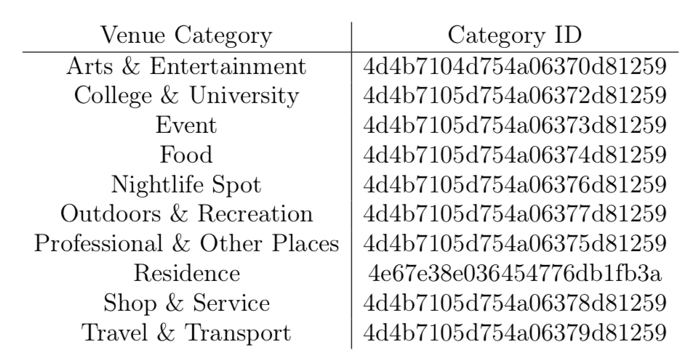
Data
Geographical data for London districts :https://en.wikipedia.org/wiki/List_of_areas_of_London
Foursquare location data for venues in these districts identified 10 key venue categories:

Slide 4
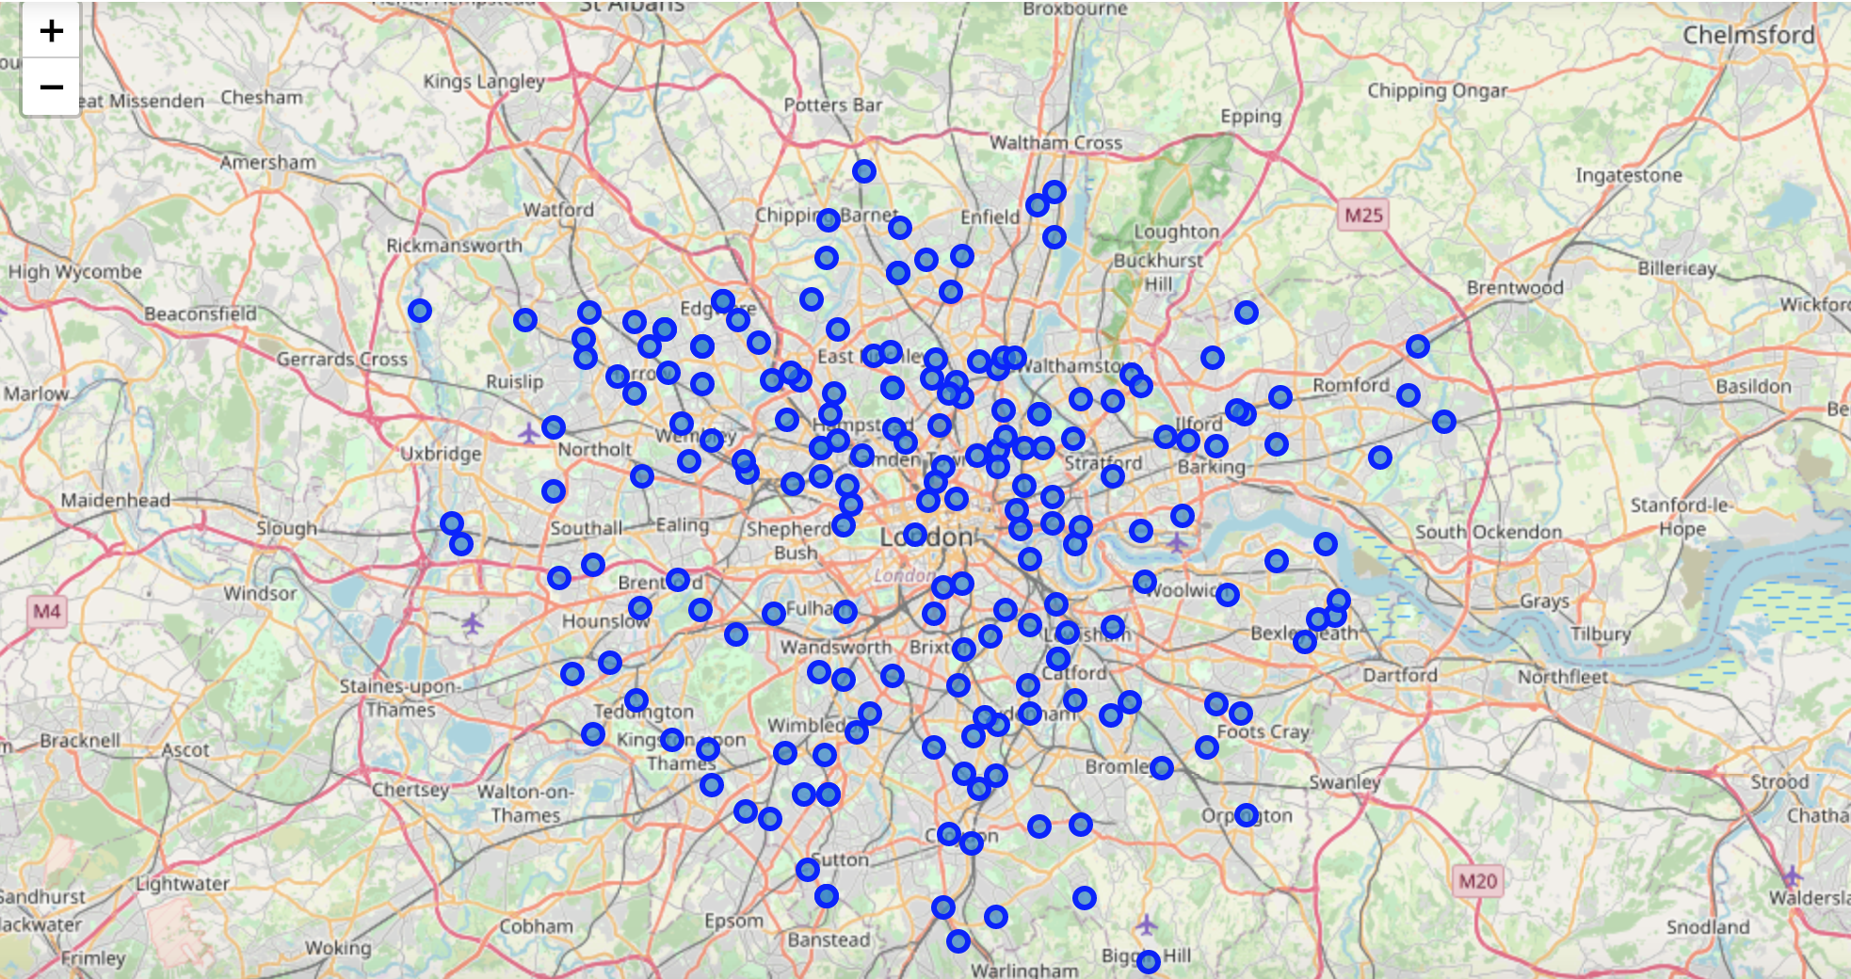
Data
Average house price for all London wards from Dec 1995 to Dec 2017: https://data.london.gov.uk/)
Cleaned data retained 194 of the 630 districts:

Slide 5
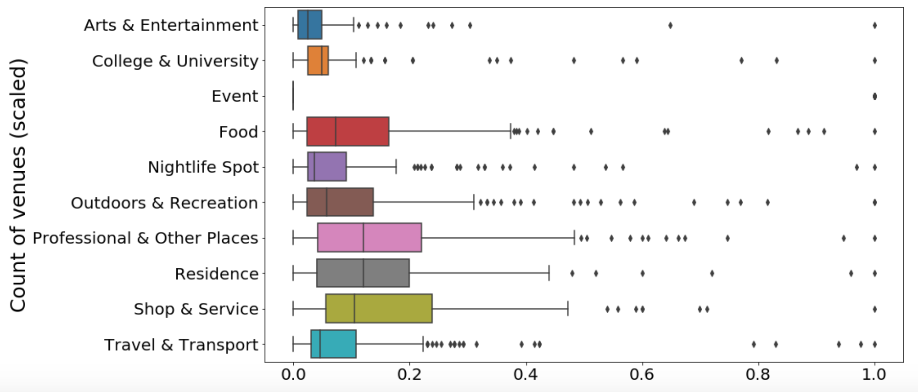
Distribution of Venue Catergories
As the Event category contain very little data it was dropped from further analysis

Slide 6
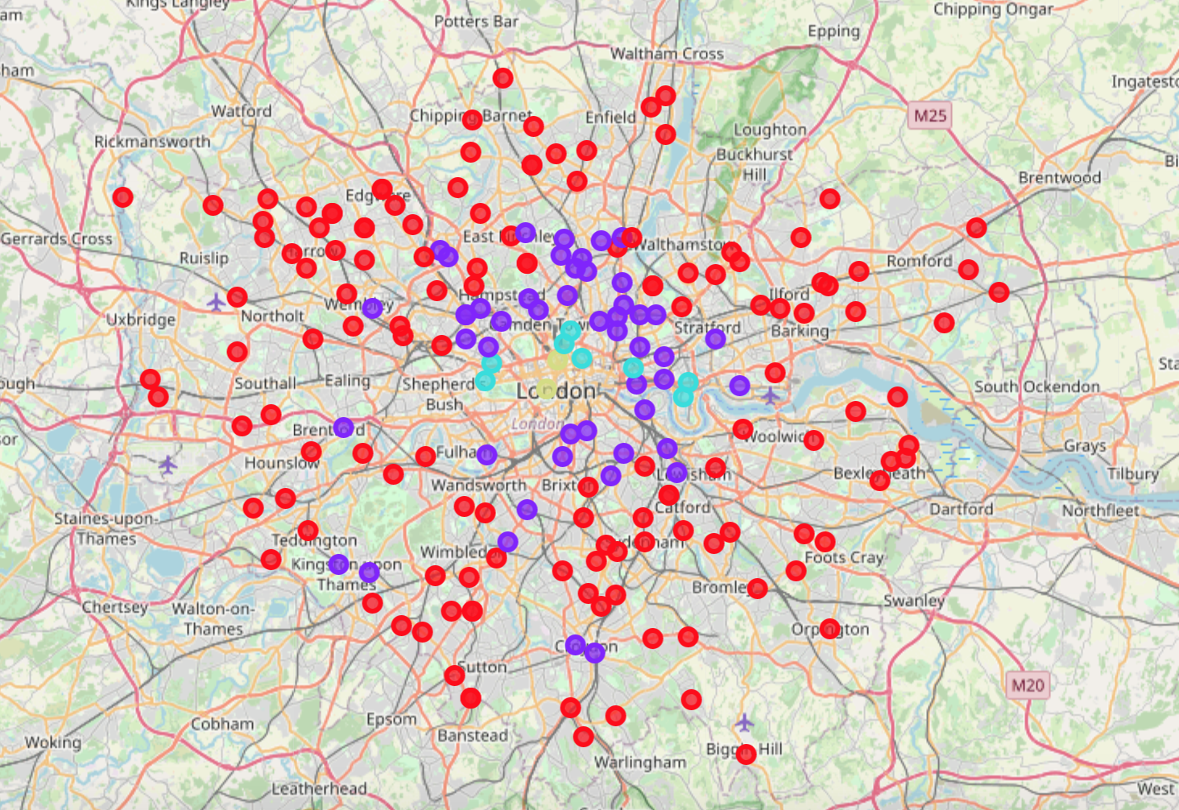
K-means Clustering
K=4 was used to divide the districts into the following categories:
Cluster 0 (red)- underdeveloped
Cluster 1 (purple)- developing
Cluster 2 (blue)-developed, residential
Cluster 3 (green)- developed, non residential

Slide 7
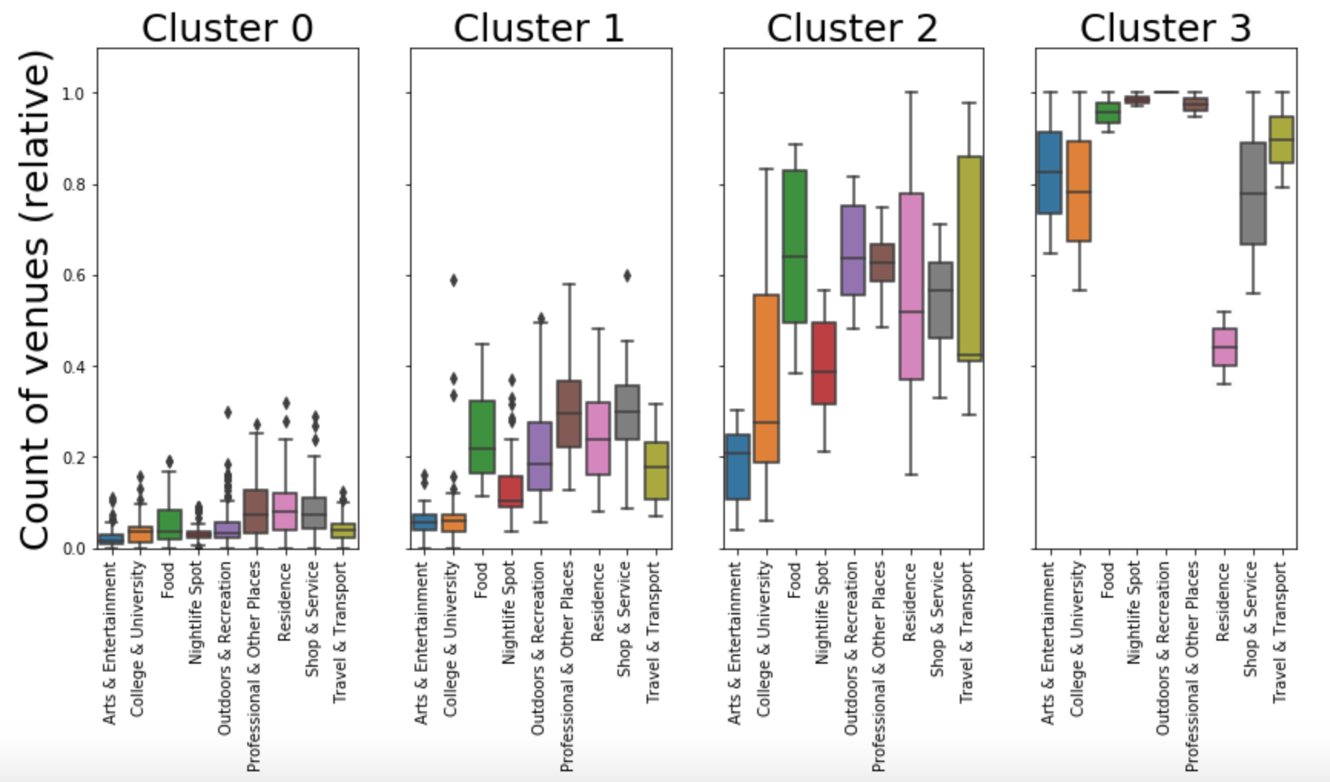

Slide 8
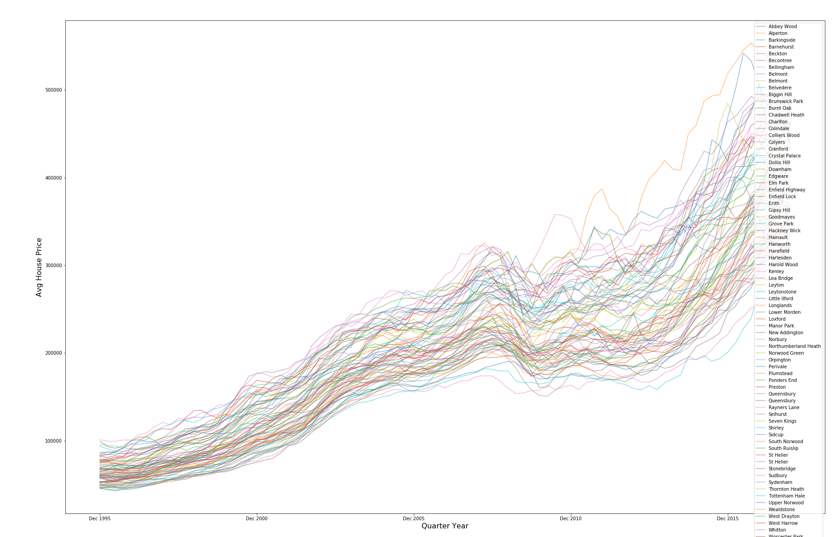
Average House Price for under-developed districts
Further subdivision was necessary in the cluster 0 underdeveloped grouping and this was done by capping the average house price (as of Dec 2017) to a maximum of £500,000

Slide 9
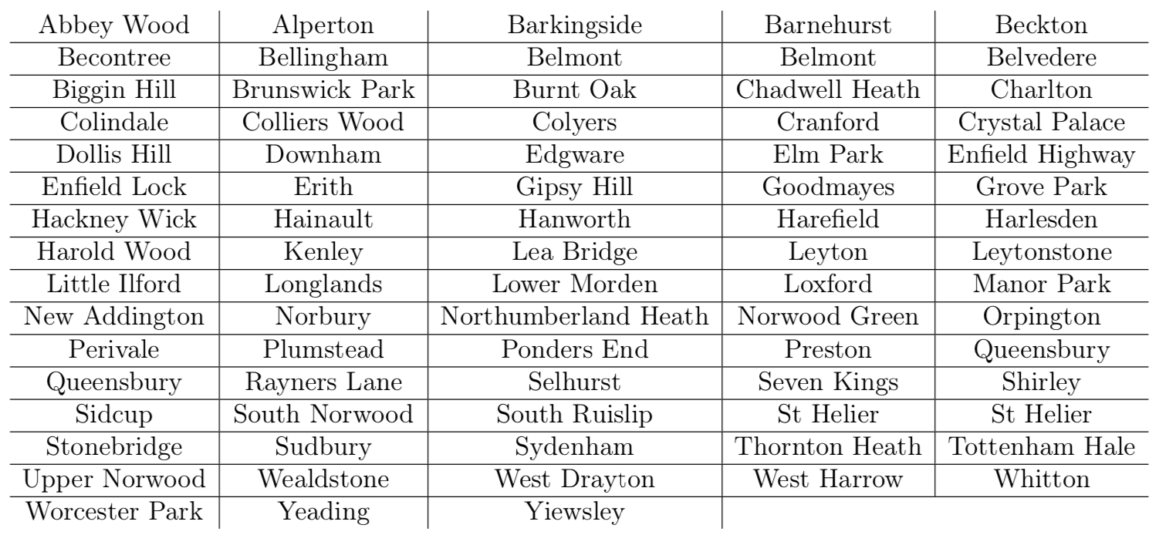
78 of 194 analysed districts identified as underdeveloped

Slide 10
Conclusion
Used K-means clustering algorithm to cluster London districts by their constituent venues into broad categories of underdeveloped, developing and developed
Further constrained those identified as underdeveloped by housing price and successfully recognised 78 areas
Future work upon this project could include:
demographics
crime rates
education
poverty
social funding

